Slide 1


Management of Organizational Data Project
Omnibiz
Redefining Retail in developing markets
Session3 | Group-3
Team - Data to Wisdom
Arpan Datta | Vinod Iyer | Mrinmayee Joshi
Rajas Kapure | Vaibhav Mathur | Sudipta Singh

Slide 2






-Team Members-
-Arpan Datta-
-Vaibhav Mathur-
-Mrinmayee Joshi-
-Vinod Iyer-
-Rajas Kapure-
-Sudipta Singh-

Slide 3

-Agenda-
-Business Scenario -
-Omnibiz Business Model -
-Project Objective -
-Business Analysis -
-Recommendations -

Slide 4

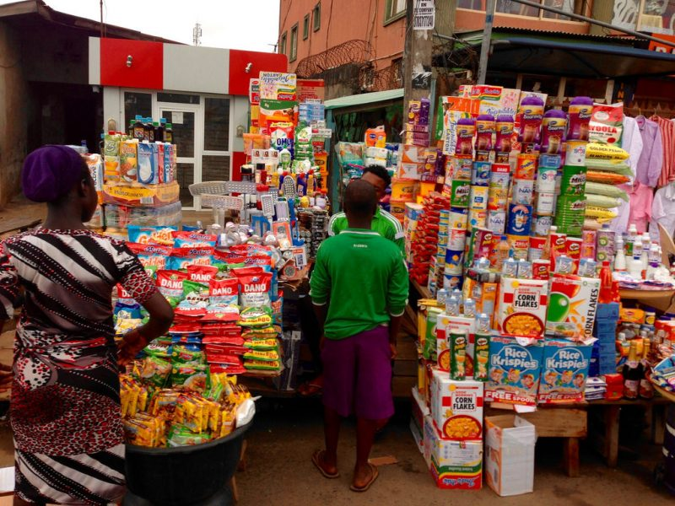

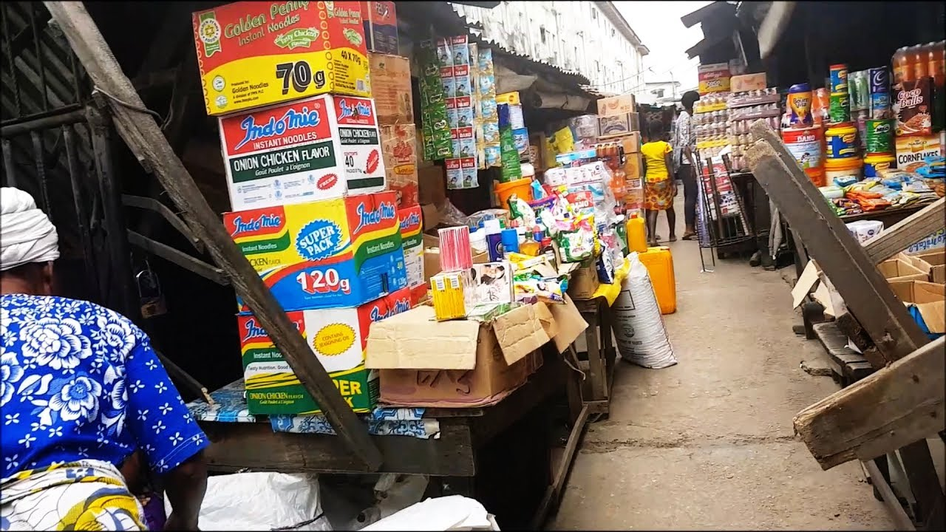

Slide 5




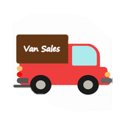

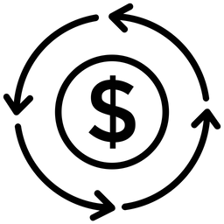
-Business Scenario -
FMCG Manufacturers fight the inefficiencies in trade.
Salesperson
Manufacturer
Low efficiency for Salesperson
Salesperson spending time in delivery
Low Order Value/Drop Size
Brand wise vans deliver single products

Slide 6

-Business Scenario -
FMCG Retailers exist in isolation and find it hard to fight the inefficiencies in trade.
STOCK OUT
Inefficient supply chain causing sales loss
HIGH COST OF CREDIT
Lacks identity for organized credit
20%
Of the retail outlets have shut down in last 5 years. Creating a retailer centric ecosystem will help retailers to survive and give distributors an opportunity to increase their reach & sales ​

Slide 7


-Omnibiz-
Omnibiz
01
A platform and team of Agents for convenient order placement for Retailers
02
Onboarded Manufacturers & Key suppliers to process orders and distribute product across Nigeria
RETAILER
MANUFACTURER
03
Exhaustive basket of products and seamless free of cost delivery
04
Provide Manufacturer with Retailer info and Retailers with Brand promotions for increasing the overall efficiencies of the trade channel

Slide 8





-Operating Model-
Order placement
Order
processing
Onboarding
Order Delivery

Slide 9
-Project Flow-
Requirements
Database Design
Get Data & Normalize
Analysis & Insights
Recommendations

Slide 10
-Problem Statement & Client Requirements-
Client:
“Can you guys help us analyze our customer performance on a month-over-month basis? We do track this, but people work on excel sheets for days to deliver this”
“We want start our marketing channel by providing brands with product insights & charging them for these reports, can you help us know if that is possible with our database”
“We have a huge team of agents working on field, can you help us in monitoring their parameter?”

Slide 11



Information Problems
Retailers
Agents
Products
Performance
Activity
& Brand performance

Slide 12
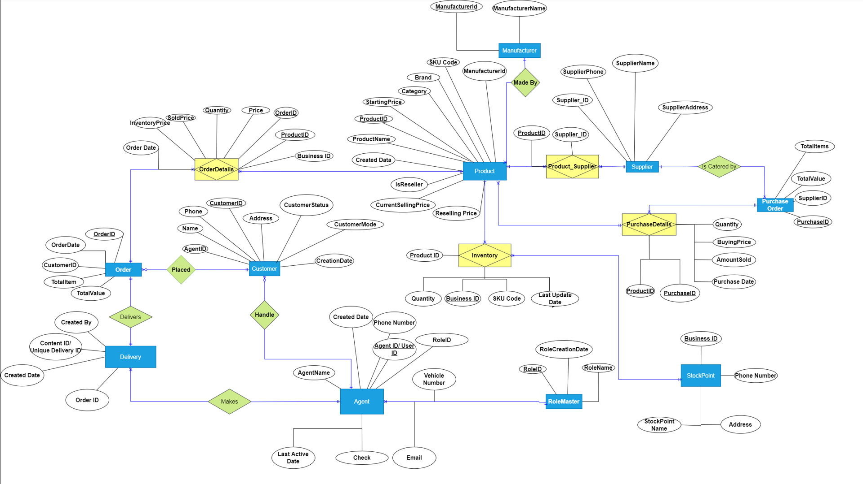
-Entity Relationship Diagram-

Slide 13
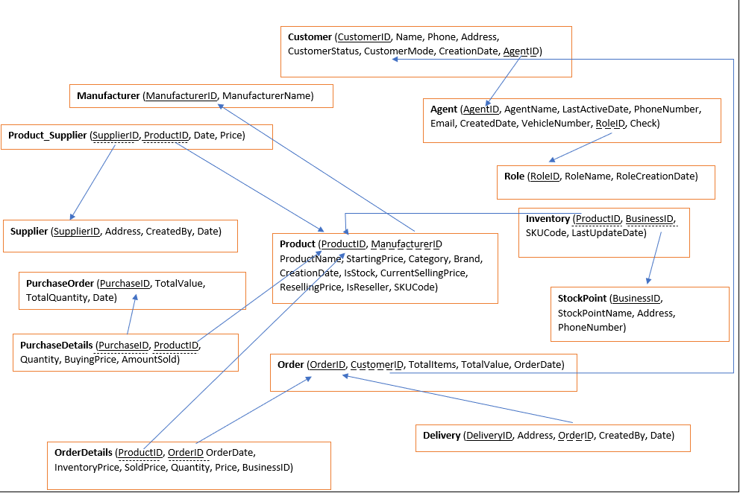
-Relationship Schema-

Slide 14
-Gathered Data & Normalization-
1
400k+
9
Master Table
Records
Entities Derived after Normalization
First Normal From
Second Normal From
Third Normal From
1 NF
2 NF
Columns that had a transitive dependency of non-key attributes were removed
Separate entities were created
Single Atomic Value in each column
Each row has a unique identifier
Columns that were partially dependent on primary keys were removed
Separate entities were created

Slide 15
Data Analysis
Retailers
Agents
Products
Performance
Activity
& Brand performance

Slide 16
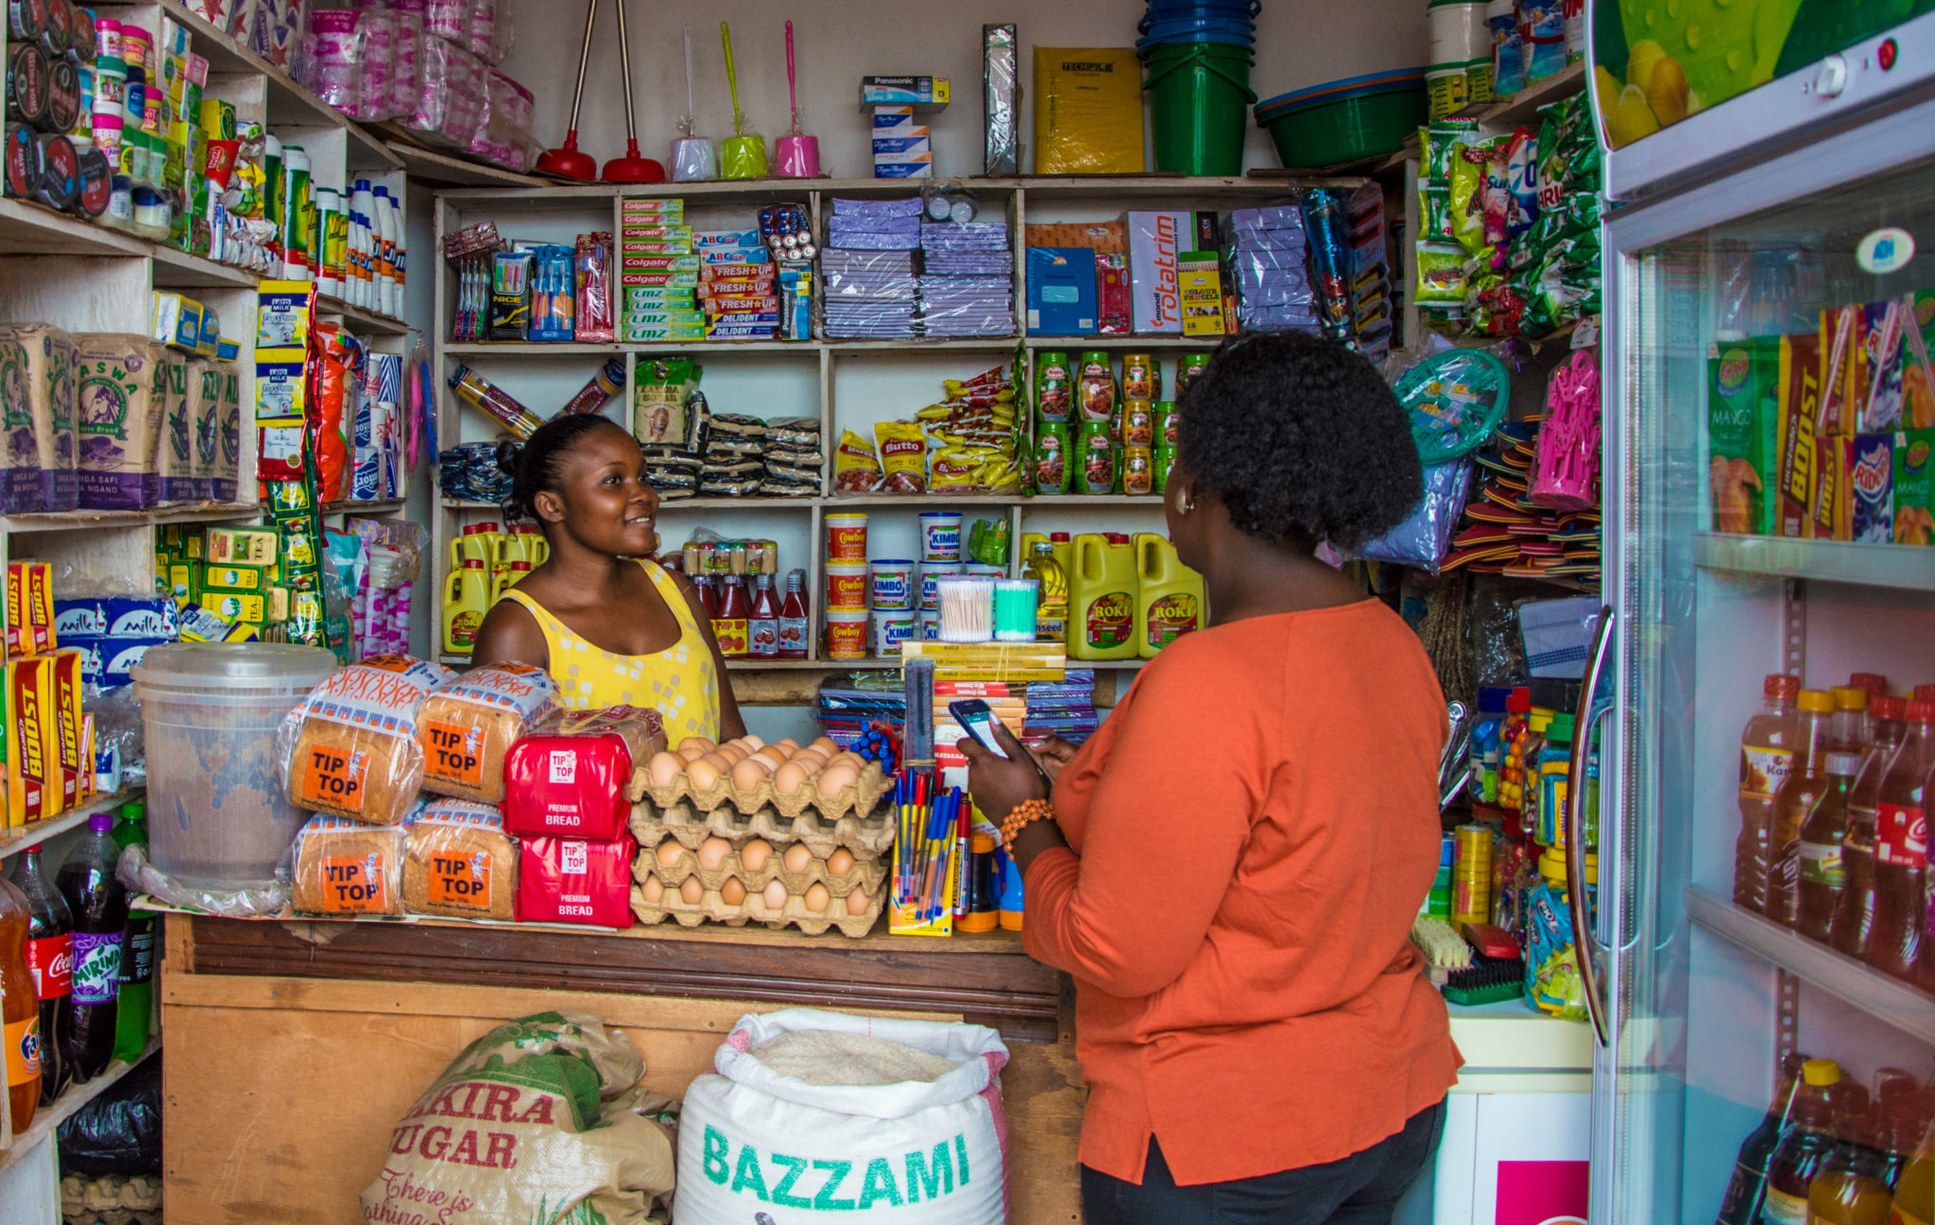

Analysis
Retailers Performance
SQL queries were written to perform the following tasks
Monitoring
Value Addition
Best performing retailers in terms of revenue
Best performing retailers in terms of no of Orders
Worst performing retailers in terms of revenue
Worst performing retailers in terms of no of Orders
Active Customers/Retailers every month.
Average revenue per retailer per month as an important business KPI
Average purchase cycle of a retailer

Slide 17

Analysis
Agent Activity
SQL queries were written to perform the following tasks
Elevating Performance
Agent performance revenue wise based on the total sales made by their customers – along with average revenue per retailer
Find out the above data for all the months.
Average revenue per customer month on month
New Customer added per month
Agent performance in selling most unique SKUs
Monitoring
Agent Last active date monitoring for past 3 days & Past 10 days

Slide 18
Analysis
Brand & Category Performance
SQL queries were written to perform the following tasks
Brand
Categories
Top Selling Brands in terms of revenue
Top Selling Brands in terms of customer reach
Information on Market share for Brand Managers
Top Selling Categories in terms of revenue
Top Selling Categories in terms of customer reach
Information on Market share for Brand Managers

Slide 19
Insights & Recommendations
Brand & Category Performance
Insights
Recommendations
Brands like Hypo and Indomie are very consistent with customer reach, but their revenue is low
Loyalty Programs: Omnibiz should attract customers to purchase high volumes by providing loyalty rewards
They should also create sampling opportunities for smaller brands by bundling with these products.
Number of customer purchasing “Beverages and Cereals” have dropped drastically in October
Category Manager: We suggest Omnibiz should assign a category manager for each category to manage the SKU bank and monitor the sales and reach
Proper maintenance of Category and Brand data can reveal valuable insights for Manufacturers to plan their marketing campaigns
Offer Marketing Reports: Omnibiz should bundle marketing insights as a product and sell it to different manufactures. They already buy these reports from research companies like Kantar & Neilsen.
www.omnibiz.com

Slide 20
Insights & Recommendations
Agent Performance
Insights
Recommendations
Overlap between Agent Performance based on Revenue & SKU
Incentive Program : Special incentives for selling more unique product apart from sales bonus. Outliers in our data shows that just sales incentive promotes fraudulent behavior.
Overlap Consistent Performers for Last Three Months based on Revenue & SKU : Agent ID 5136691, 5138823, 1905625 and 3993012
Agent Appreciation : All such agents should be celebrated on quarterly basis by putting photographs in office and special Gifts to motivate other Agents for constant performance rather than one time success.
Multiple Agents with more than 3 and more than 10 inactive days
Agent Tracking : Agents with more than 3 days inactivity should be contacted and warned. Agents with more than 10 days of inactivity should be given official Notice.
www.omnibiz.com

Slide 21
Insights & Recommendations
Retailer Activity
Insights
Recommendations
Limited Overlap in monthly Lists of Best Performing Customers by Revenue
Increase Customer Base: Customers are not yet buying consistently ( has been validated with low active customer base ). Marketing efforts are required
Reduce Minimum Order Quantity: Omnibiz can reduce the minimum order quantity so that customer need not wait to order product in large quantites
Average customer buying frequency is very low. Increase frequency in order to generate stickiness and habit.
Unique SKU count is low for most of the customers Major Concern for a Retail business hence needs to be focused
Training & Development: A thorough customer and Agent training is required for cross selling and up selling
www.omnibiz.com

Slide 22
Further Recommendations
For better Insights & Marketing Revenue Stream
Credit Score
Omnibiz should collect Photos of store to analyze total inventory value and for Brands
Omnibiz should distribute branded merchandise materials as some discussions with omnibiz customers yield that it makes big impact
Design POS solution for retailers to capture further data
Omnibiz should capture Customer information like income, marital status, property ownership etc to build a model of credit worthiness
Training & development
Omnibiz should create a standardize training program for all agents to give customers a consistent service.
www.omnibiz.com

Slide 23
Next Steps & Future Scope
Expanding Portfolio
Give inputs regarding expanding product portfolio to increase sales per customer
Providing business dashboard
For real-time performance measurement
Value adding insights
Monitoring team to increase efficiency
Credit Score for customers
Analyze customer data and recommend a credit rating to facilitate Omnibiz in extending credit lines to their customers while minimizing the default rate

Slide 24
-Proposed Dashboard-
SALES PERFORMANCE DASHBOARD
OMNIBIZ | MTD | YTD
AMOUNT | 74,556,764 | 398,471,620
# OF NEW STORES REGISTERED | 2,298 | 19,462
TOTAL NO. OF ORDERS | 2,270 | 12,534
NEW | 1,205 | 7,315
MTD ACTIVE CUSTOMERS | 1,908
LAST 30 DAYS ACTIVE CUSTOMERS | 4,180
Delivered Orders: 11,692
Revenue per Agent: 70,692
Total Customers: 7315
Count of Unique Customers | 5256 | 1016 | 426 | 231 | 128 | 258
Frequency | 1 | 2 | 3 | 4 | 5 | 6 +

Slide 25
Vision
To be the preferred growth partner of the retail ecosystem in developing markets
Mission
Help Team Omnibiz in maximining retailers’ revenue with the limited capital they have

Slide 26

Thank You ☺ -
Any Questions?
Alguna Pregunta?
任何问题？
اي سؤال
Rènhé wèntí?
ay sual

Slide 27
